Slide 1

How to access support
Sue O’Hara
Transition and Integration Officer

Slide 2


Accessing support
Starting at a new university might be exciting and fulfilling but that doesn’t stop it being overwhelming sometimes. And sometimes life can get in the way too. None of this is a failure.
At Exeter University there are lots of people to help. Here are a few and what they specialise in.
Start by watching our new ‘introducing’ videos

Slide 3
Arrival
Welcome Team
Ambassadors
Administration
Student Information Desk (SID)
Digital Hub
Education
Info Point/Hubs
Personal Tutors
Immigration
Personal
English Language Support
Study Skills Support
International Student Support
Student Health Centres
Disability Support
Study Abroad Office
Wellbeing Services
Dignity and Respect
Multifaith Chaplaincy
Residence Life
Community Wardens
Campus Security
Students Guild/
Students Union

Slide 4
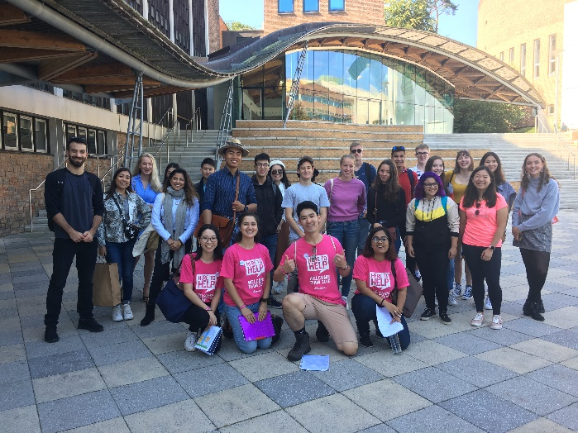
Help during Freshers’ Week:
Welcome Team (Exeter), Ambassadors (Cornwall)
Our Welcome Team and Ambassadors in Freshers’ Week are made up of a dedicated group of student volunteers. At Exeter you can see them in their distinctive pink t-shirts ! You may even see them at Heathrow if you arrive on one of our Airport Collection days.
When to speak to the Welcome Team
Answer any questions you may have
about being a new student
Give campus tours and help marshal events
How to access them:
Just go and say hi!

Slide 5

Administration: SID
Our Student Information Desk (SID) advisors are your contact for non-academic enquiries.
When to contact SID:
Accommodation
Fees/funding/how to pay your fees
Coronavirus
Letters, transcripts and certificates
Frequently asked questions (FAQs)
How to access:
Log an enquiry through SID Online or the web or app version of iExeter.
By phone: 0300 555 0444 (UK) or +441392 724724 (International)
In person: Forum or Info at St Lukes or Info at Penryn

Slide 6

Administration: Digital Hub
So much of our academic and personal life is now conducted online. Our Digital Hub
can help you make the most of the digital tools we all use and maximise your online learning.
When to contact Digital Hub:
Book time with an expert to problem solve
Watch and Espresso Session ‘how to’ video
Stay safe with Essential IT security
How to access:
The Digital Hub - Home (sharepoint.com)
Go and see them in the Forum
(mezzanine level by Alumni Auditorium)

Slide 7
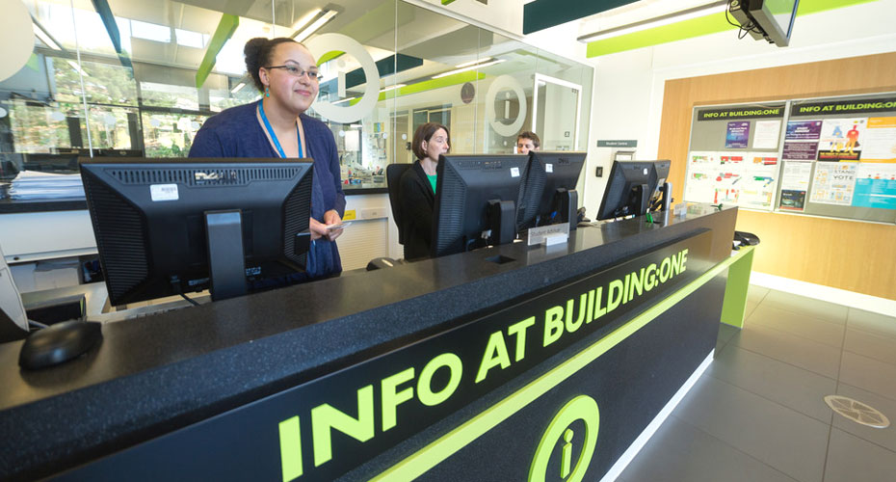
Education support:
Info Points and Hubs
Info points are physical open in most locations and are there for all your education support needs. Advice can be confidential and won’t be shared unless you say so.
When to contact Info Point or Hub:
Questions about submitting work
Discussing mitigation (ie. Too unwell to take an exam, test or submit work)
Welfare support (if a health or personal
problem is affecting your studies)
Changes to your study programme, interrupting
How to access:
Email Info Point/Hub
Go and see them in your academic building
Call them

Slide 8

Education support: Personal Tutors
Each student is allocated a personal tutor within your academic department. Your personal tutor will contact you at the beginning of your studies and be in contact regularly. You will meet them or have online meetings throughout your studies.
When to contact your personal tutor:
Questions about your academic studies
Personal issues
Professional development
Helping you understand feedback on
assignments and how to improve
Click here for more information about personal tutors
How to access:
Email them
Go to their ‘office hours’ drop ins

Slide 9
Education support:
AccessAbility (disability support)
AccessAbility is made up of a team of disability specialists dedicated to supporting students with a disability or long-term health condition including Specific Learning Difficulties and Autism Spectrum Conditions.
When to contact AccessAbility:
Specific learning difficulties such as dyslexia and dyspraxia
Asperger Syndrome or Autism Spectrum Conditions
Physical disabilities
Blind or visual impairment
Deaf or hearing impairment
Long term medical conditions such as epilepsy, diabetes or arthritis.
Temporary injuries, e.g. a broken leg
Mental health difficulties and one or more of the above health problems
How to access:
Exeter: book an appointment
Virtual drop in session
Penryn: book online appointment

Slide 10

Education support: Study Abroad
Our Inbound Study Abroad Team is there to offer help and advice to exchange students who are studying at Exeter for a semester or a year.
When to contact Inbound Study Abroad:
Documents from your home university to sign
Module selection and timetabling
Any other education or transition issues
How to access:
Email: inbound@exeter.ac.uk
Instagram: @exeterabroad

Slide 11

Education support: English Language Support and Study Skills
English language support is available at both our campuses where we provide a range of free English language and study skill support classes. It’s a great way to improve your confidence in your language abilities and your studies.
Exeter: About the programme | INTO University of Exeter | University of Exeter
Cornwall: Languages | StudyHub (fxplus.ac.uk)
Adapting to a new study culture can be hard. To make the most of your time, our
Study Zone provide advice and support through
Peer support
1:1 appointments
Writing cafes, events and workshops
Digital study resources
How to access:
Exeter: Study Zone | Study Zone | University of Exeter
Penryn: Learning Skills and Support | StudyHub (fxplus.ac.uk)

Slide 12

Immigration:
International Student Support
Our team of trained immigration advisers provide
advice and support on a range of topics.
When to contact International Student Support:
Pre arrival information
Healthcare and living in the UK
Visa and immigration advice service –
student visa, visitor visa, working visas (graduate
route), EU settlement scheme and how changes
in circumstances may
affect your immigration status
Visa application service (applying for
student visa in UK
Advice on lost or stolen passports/BRPs
How to access:
Email visaadvice@exeter.ac.uk
Log SID enquiry (immigration)
Call 0300 555 0444 (UK)
+441392 724724 (International)

Slide 13

Personal: Student Health Centres
Our Student Health Centres provide access to NHS nurses and GP’s (general practitioner doctors) for a range of health concerns. We recommend you register with a Health Centre once you have registered with the university.
When to contact Student Health:
Routine Medical Care
Nursing Services
Travel Health
Minor surgery
Physiotherapy
Sexual Health and contraception
Vaccinations
How to access:
Exeter Streatham: Exeter Student Health Centre
Exeter Heavitree: The Heavitree Practice
Penryn: Penryn Surgery

Slide 14
Personal: Wellbeing
Wellbeing Services are here to help students get the most out of their time at University. We recognise that it’s much more difficult to learn and enjoy student life when practical and personal difficulties arise. Wellbeing Services can offer a range of services to support you.
Confidential support for students experiencing difficulties with mental health/wellbeing
Qualified therapists and Wellbeing Consultations
Workshops and groups
Links to support outside the university
Individual Learning Plans (ILP) that are shared with your college to help with reasonable adjustments for your teaching and learning needs
Urgent support, appointments,
self help and peer support
Relaxation and mindfulness audios
Exehale space in Devonshire House Streatham Campus providing a quiet and relaxing area for all students.
How to access:
Exeter Streatham: Student Wellbeing
Penryn: Support & Wellbeing – FX Plus

Slide 15

Personal: Dignity and Respect
Exeter is an inclusive community, where everyone has the right to be treated with respect. Harassment, bullying, intimidation, and discrimination go against all we stand for and will not be tolerated. If you’ve experienced or witnessed any of the above we encourage you to report it and to get the support you need.
When to contact Exeter Speaks Out:
Help and advice
Report incident confidentially
Dignity and respect advisers
Guidance for dealing with online
abuse/harassment
How to access:
Full details on Speak Out website
Equality, Diversity and Inclusion (EDI)

Slide 16
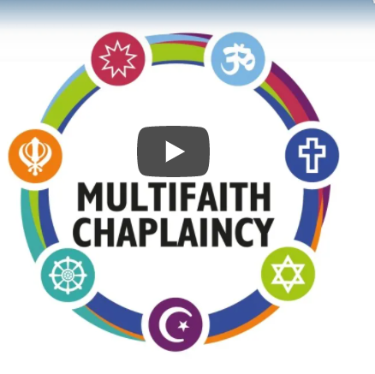
Personal: Multifaith Chaplaincy
The Multifaith Chaplaincy Team is made up of volunteers drawn from a wide variety of faith backgrounds and worldviews including Bahá'í, Buddhist, Christian, Hindu, Humanist, Muslim, Jewish and Quaker, supported by a Multifaith Coordinator. They pastoral support for students and staff of all faiths or none and hold regular events.
When to contact our Chaplains:
Feel anxious or worried
Experience a bereavement
Feel stressed, isolated or homesick
Exploring a particular faith/worldview or spiritual meaning
How to access:
In person and online
Exeter Chaplaincy | Chaplaincy in Exeter | University of Exeter
Cornwall Chaplaincy Chaplaincy – FX Plus

Slide 17
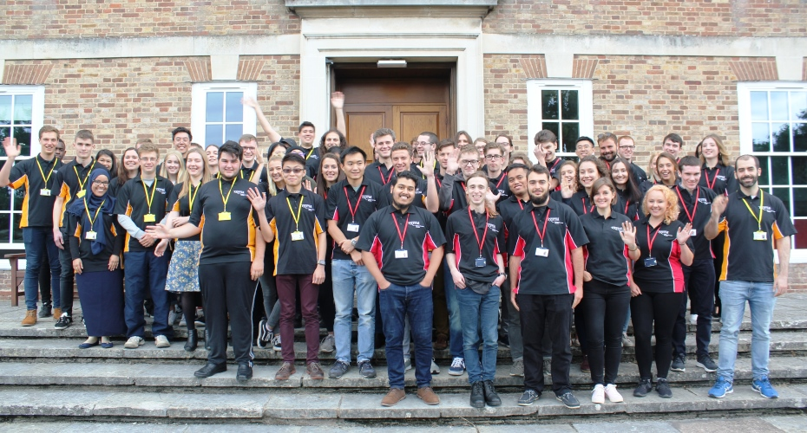
Personal: Residence Life Team
The Residence Life Team is part of the wider welfare department at the University and are here to provide support, guidance and advice to students living in University accommodation. They hold regular social events. If you are living in university accommodation you will be assigned a peer-support Residence Life Mentor.
When to contact the Residence Life Team:
Flatmate issues or conflicts
Harassment and bullying concerns
Accessing further wellbeing support
Second year housing concerns
Friendly and empathetic listening ear
Academic concerns
Advice about student life
How to access:
Exeter residencelife@exeter.ac.uk
Instant Chat 1800-2100 every night: Residence Life Team | Accommodation | University of Exeter
Penryn: ResLife – FX Plus

Slide 18
Personal: Community Wardens (Exeter)
Community Wardens provide information and guidance to students living and socialising in private accommodation in the community.
When to contact Community Wardens:
Refuse/Recycling/Bins
Household security and personal safety advice
Landlord and neighbour concerns
How to get involved with your local community.
How to access:
emails: studentcommunitywardens@ex.ac.uk
tel 01392 723721
http://www.exeter.ac.uk/about/community/uni/

Slide 19

Personal: Campus Security
Estate Patrol (Exeter) and Campus Security (Penryn) are our mobile, response based service covering all aspects of security, safety and welfare for staff and students. They are available 24 hours a day, 365 days a year.
When to contact Campus Security:
Fire, intruder, lift and security alarms on campus
Anti-social behaviour and noise complaints
If you have locked yourself out
of your university residence
Security of property and personal safety
Reporting incidents
How to access:
Exeter telephone: 01392 723999 Emergency: 01392 722222
Exeter: Estate Patrol
Penryn telephone: 01326 255875 Emergency: 01326 25444
Penryn: FX Plus Campus Security

Slide 20
Personal: Students Guild (Exeter)
Students Union (Penryn)
The Students’ Guild (Exeter) and Students’ Union (Penryn) support student activity on campus, represent the student voice, provide independent advice and much more. As a member of the university you are automatically a member of the Students’ Guild/Students’ Union unless you opt out. You can be a representative for your course through SSLCs (student staff liaison committee), run to be a sabbatical officer or just enjoy what there is to offer.
Students’ Guild (Exeter)
150 student social societies
50 student sport societies
In person and online events
Represent your voice
Advice service: finance, academic,
accommodation, welfare
Students’ Union (Penryn)
150 student groups
In person and online events
Represent your voice
Advice service: finance, academic,
accommodation, welfare

