Slide 1
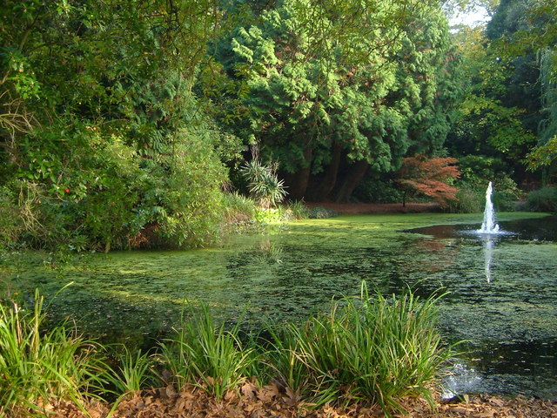
Reed Hall Pond
A bioblitz pond dip
(The contributor of this photos is Derek Harper)

Slide 2
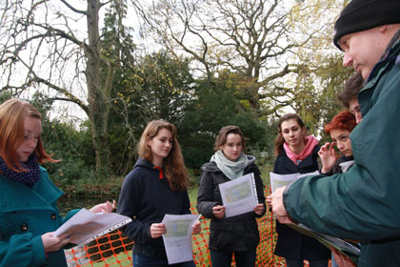
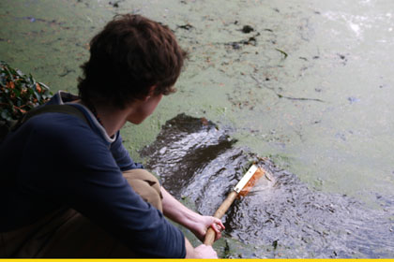
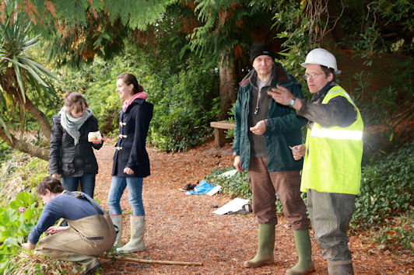
Basic facts
6 sites, 3 hours of sampling
23 different animals
  1 fish
  1 species freshwater snail
  1 mayfly species
  2 species damselflies
  3 species cased caddisflies
  2 species beetles
  2 different water bugs
  1 species fly
  2 species crustacean
  1 species water mite
  3 different oligochaete worms
  2 different leeches
6 different aquatic/emergent plants

Slide 3
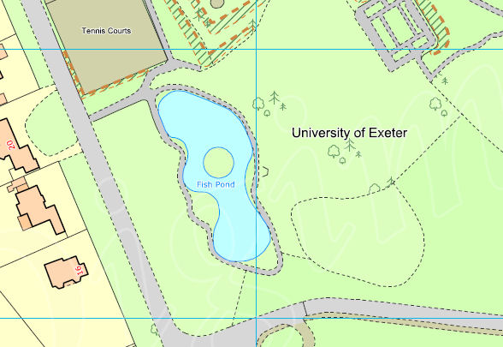
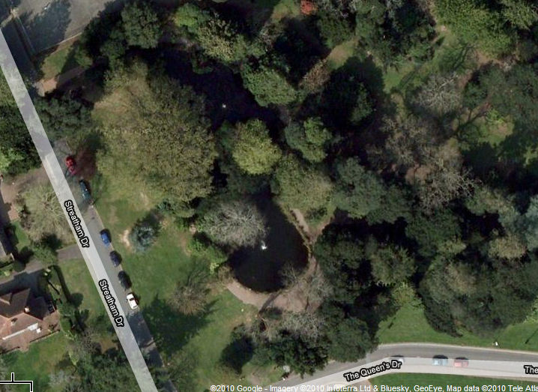
The site
Sample site
4
1
5
2
6
3

Slide 4
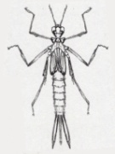


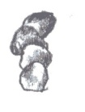
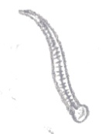

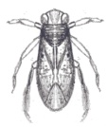

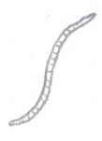
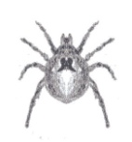
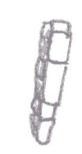

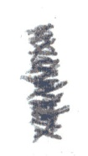
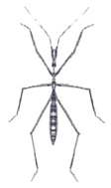
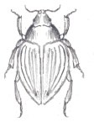

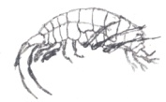
What we found
4
1
5
2
6
3

Slide 5
Basic stats
4
1
5
2
6
3

Slide 6
Canopy shading
4
1
5
2
6
3

Slide 7
What’s going on?
Impact of fountain
4
1
5
2
6
3

Slide 8
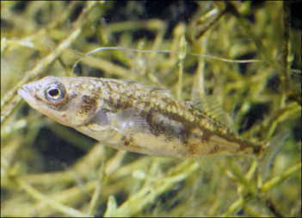
Number of taxa and Diversity
4
= Diversity index
1
5
2
3X
6
3
4X
1 = 1 taxon, 2 individuals
3.6X
3.4X
2,424 X

Slide 9

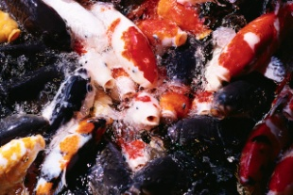
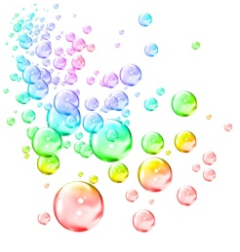
Reasons?
Shading = reduced light = less phytoplankton production?
Shading = leaves = organic input, too much?
Shading = hiding places for Koi carp = heavier predation of invertebrates?
Poorer aeration (unlike other end with a fountain)?

Slide 10
As a result…
Foliage trimmed back, larger plants removed
Leaf litter dredged
Removed choking pondweed
Whole pond aerated
Koi carp netted off
More habitats for invertebrates created
Second fountain running

