Slide 1

PREPARING FOR university

Slide 2
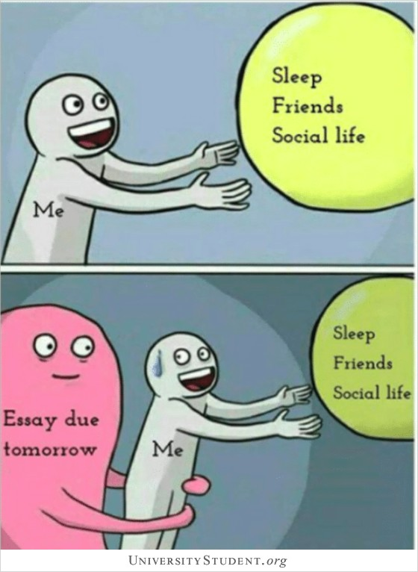
Transitioning to university life can be daunting for anyone. It's hugely exciting but a massive change with a lot of unknowns.
While you can't prepare for everything, you might feel better knowing that you’ve done as much as you can and…you have a plan to manage the unexpected.
Where to start…

Slide 3
DECLARING A DISABILITY TO THE UNIVERSITY
If you have a mental health condition and medical evidence that supports this, have you declared this to the university?
You can do this by completing the Online Prospective Student Form.
…The prospective student form will ensure that a many of the next bits are covered!
https://www.exeter.ac.uk/students/wellbeing/support/prospectivestudents/form/

Slide 4
ACCOMMODATIOn
Have you applied for accommodation?
Have you requested that Wellbeing Services support your accommodation application?
Have you applied for accommodation subsidy if eligible?
https://www.exeter.ac.uk/accommodation/

Slide 5
DISABLED STUDENTS’ ALLOWANCE (DSA) & MENTAL HEALTH MENTORING
If you have a mental health condition and medical evidence that supports this, you may be eligible for DSA.
Check your eligibility… AND APPLY!
WHY IT’S IMPORTANT -
Mental Health Mentoring is accessed and funded by DSA. Mentoring offers support for students who may face barriers to learning due to a variety of mental health conditions.
Notes:
Working with the student on a one-to-one basis throughout the academic year, mentors provide interventions to enable the student to manage their mental health in relation to their academic studies.

Slide 6
Individual Learning Plan (ILP)
Have you informed the university of any adjustments required to support your learning and had an ILP created?
What’s an ILP?
It’s a document that informs your Faculty of the recommended reasonable adjustments that may be put in place once you have declared a disability.

Slide 7
Continuing Treatment While at University
Have you discussed continuity of care with your GP or current healthcare provider?
Do you have enough medication to last until you can make use of the local Student Health Centre (SHC)?
If you are currently under the care of a community mental health team, have they arranged for a transfer of your care to local services if required?
Notes:
The earliest you can register with the SHC is September. Registration is important as some services rely on postcode and can ONLY be accessed through your GP.
The university wellbeing services are not affiliated with local NHS community mental health teams provided by Devon Partnership Trust. This includes the ‘University Community Mental Health Team'. This means that the university wellbeing team does not have access to community team referrals/waiting lists or specific patient information.

Slide 8
You may want to consider what support is available once you’re here…
Familiarise yourself with the Exeter University Wellbeing Services website. It has a wealth of information and resources.
Explore services available locally.
Make a note of the contact details for urgent services.
SERVICES AVAILBLE…

Slide 9
Cognitive Behavioural Therapy-based TALKWORKS NHS can be accessed by self-referral online or over the phone: TALKWORKS | Mental Health Support for Devon (dpt.nhs.uk) This team will support you if you are struggling with anxiety, depressed mood, stress or if you are experiencing a long-term health condition that is impacting on your mental wellbeing. TALKWORKS have short waiting lists and flexible appointments.
Margaret Jackson Centre use a range of counselling styles.
https://www.margaretjackson.org.uk/ (01392 256711) This service is SELF-FUNDED but low cost.
Choose your own therapists or counsellor. We highly recommend using the British Association for Counselling and Psychotherapy (BACP) website to ensure that individuals are appropriately qualified and meet your requirements. https://www.bacp.co.uk/search/Therapists
Contact numbers for urgent/crisis services
24/7 365 days a year - THE MOORINGS Exeter https://www.mhm.org.uk/the-moorings-devon (07990 790 920);
NHS FIRST RESPONSE (FRS) https://www.dpt.nhs.uk/our-services/first-response-service (0808 196 8708)

Slide 10
TALK TO FRIENDS & FAMILY – MAKE A PLAN FOR THE UNEXPECTED
There are lots of different ways to think about and write a plan for a crisis...
The most important part is that it is meaningful and easily accessible to you and your family as well as any professionals who might be included. Including practical details like contact numbers is also really useful.

Slide 11
IMPORTANT LINKS & Further Info -
Transitioning to University Life - https://www.studentminds.org.uk/transitionintouniversity.html
Exeter University Wellbeing Services Website - https://www.exeter.ac.uk/students/wellbeing/
What does it mean to declare a disability to the University? https://www.exeter.ac.uk/students/wellbeing/mental_health/declaring/
Online Prospective Student Form - https://www.exeter.ac.uk/students/wellbeing/support/prospectivestudents/form/
Step by Step handy DSA guide - https://www.exeter.ac.uk/students/wellbeing/support/fundingyoursupport/
More about Mental Health Mentoring - https://issuu.com/universityofexeter/docs/specialist_mental_health_mentoring
More about ILP’s - https://www.exeter.ac.uk/students/wellbeing/support/individuallearningplans/
Student Health Centre (You can register online from September) - https://www.exeterstudenthealthcentre.co.uk/

